Slide 1
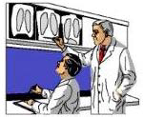
X-RAY FILM READING MADE EASY by :dr.sara sadeq (R4)

Slide 2
how to read an x-ray
Bone – appears light grey or white because it absorbs a high percentage of the x-ray (metal is pure white)
Tissue – appears a greyish color because it absorbs some but not a majority of the x-ray (water or fat, for example)
Air – appears black because it absorbs a very low percentage of the x-ray (gas, for example)

Slide 3
BASICS
Figure #1(left). The red arrow
points to the black density of gas
seen in the right side of the colon.
The yellow arrows indicate the
slightly lighter density (than gas)
of fat in the left hip joint capsule.
The blue arrow shows the bright
density of metal (mineral) in the
“R” of the film marker. Mineral
density, not quite as bright as the
heavy metal marker, is also noted
throughout the bones of the
skeleton.

Slide 4
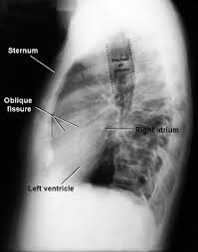
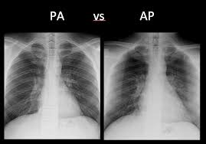
Chest x-ray basic systematic approach (in to out /out to in ) the checklist,
PA ,AP and lateral view
- determining whether the x-ray penetrated through the patient from the front or the back..
-A posteroanterior(PA) x-ray comes from the back ( best)
- A anteroposterior(AP) x-ray comes from the front (IN ER)-show large heart size and elevating diaphragm.
-lateral chest view examines the lungs, bony thoracic cavity, mediastinum, and great vessels.

Slide 5
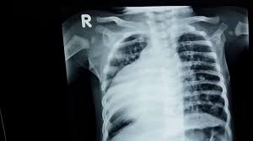
1- name of the patient
2- date of the x-ray
3- Exposure an under-exposed image will be too white and an over –exposed image will be too black
4- Right and Left of the patient (always keep in your mind right side of the screen is left side of the patient )
5-checklist (A-B-C-D-E-F)

Slide 9
-trachea :
normally central
Deviated (toward the lesion )or (away from lesion)
bronchus Left horizontal more than right bronchus(aspiration more in left)
Bone:
include the clavicles, the ribs, the scapulae, part of the spine, and the proximal humeri
The ribs play a role in assessing the adequacy of inspiration taken by the patient.
The anterior end of approximately 5-7 ribs should be visible above the diaphragm in the mid-clavicular line. Less than this indicates an incomplete breath in, and more than 7 ribs(ant) or >10 post) or flattening of the diaphragm, suggests lung hyper-expansion
The spinous processes of the vertebrae (posterior structures) should lie midway between the medial ends of the clavicles (anterior structures)
Antanterior ribs hard to see but the posterior rib easier
If the spinous processes are not central, then the patient is rotated - positioned obliquely to the X-ray beam.
Heart :
-normally <15 cm across ( 50% of the width of the thorax
Diaphragm :
-right side >left side ( why?)
Curve not flight
Plural and lung
costophrenic angle
Gastric air
Lobe of the lung
oblique and horizontal fissures

Slide 12
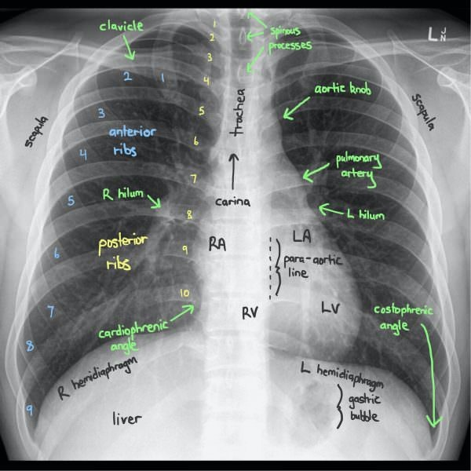

Slide 13
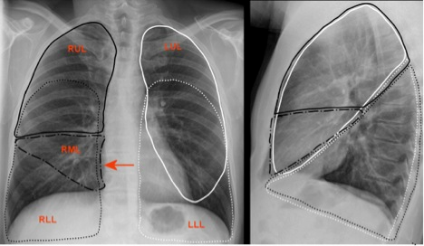

Slide 14
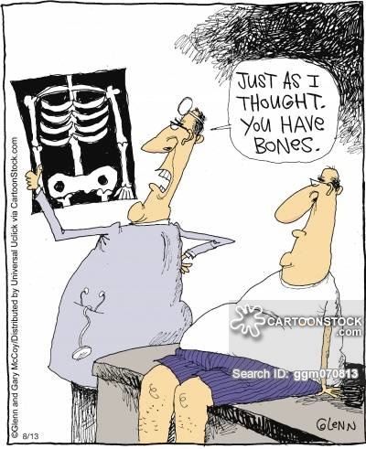
EXAMPLES

Slide 15
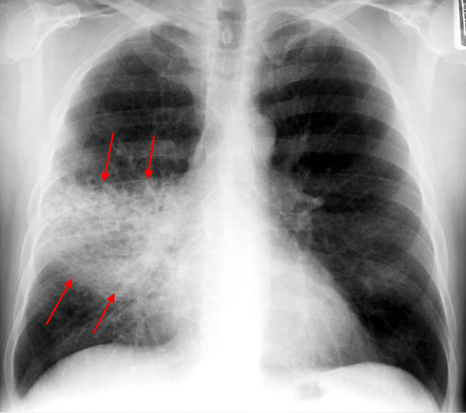
Lobar pneumonia
homogeneous opacification in a lobar pattern.
Radioobaque shadow occupying the middle lobe of the right lung

Slide 16
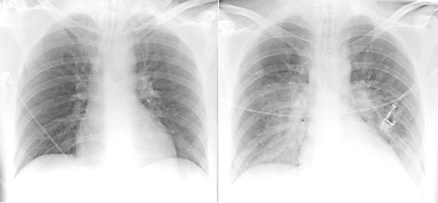
bronchopneumonia
multiple small nodular or reticulonodular opacities which tend to be patchy and/or confluent. This represents areas of the lung where there are patches of inflammation separated by normal lung parenchyma.
Notes:
multiple small nodular or reticulonodular opacities which tend to be patchy and/or confluent. This represents areas of the lung where there are patches of inflammation separated by normal lung parenchyma. ².

Slide 17
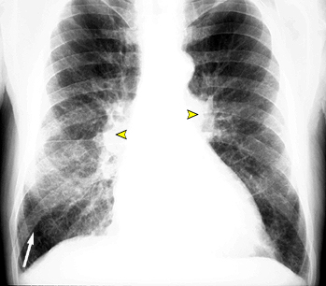
Heart failure
-pleural effusions, cardiomegaly (enlargement of the cardiac silhouette), Kerley B lines (horizontal lines in the periphery of the lower posterior lung fields), upper lobe pulmonary venous congestion and interstitial edema.
A good mnemonic to remember these principles is ABCDE:
A - alveolar edema (bat wing opacities)
B - Kerley B lines.
C - cardiomegaly
D - dilated upper lobe vessels
E - pleural effusion
Notes:
Chest x-ray findings include pleural effusions, cardiomegaly (enlargement of the cardiac silhouette), Kerley B lines (horizontal lines in the periphery of the lower posterior lung fields), upper lobe pulmonary venous congestion and interstitial edema.
A good mnemonic to remember these principles is ABCDE:
A - alveolar edema (bat wing opacities)
B - Kerley B lines
C - cardiomegaly
D - dilated upper lobe vessels
E - pleural effusion

Slide 18
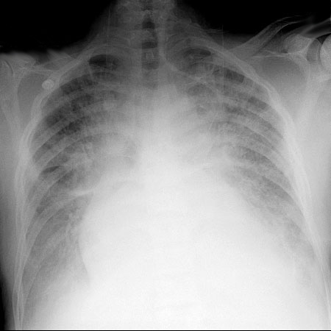
Heart failure

Slide 19
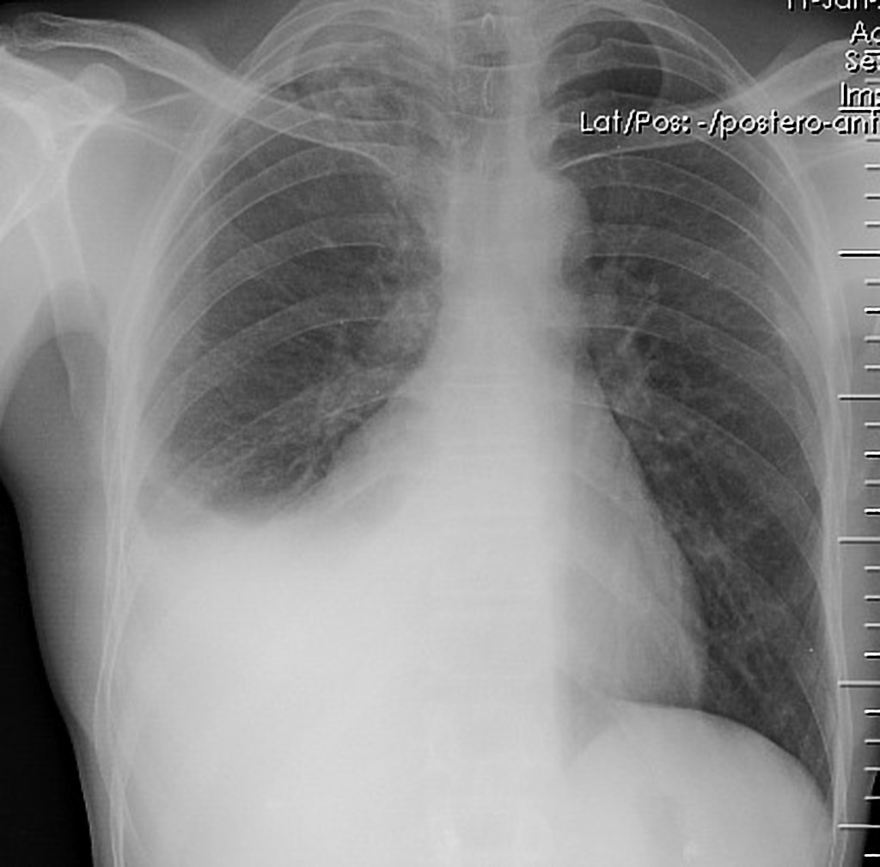
Pleural effusion
A homogenous opacification is noted in the right lower zone with the opacity seen to track along the lateral chest wall. The right costophrenic angle is obliterated with a meniscus noted. Findings are suggestive of a right sided pleural effusion

Slide 21
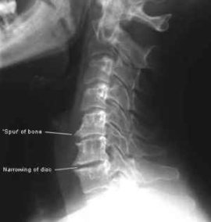
Cervical spondylosis
Osteophytes
Disc space narrowing
Loss of cervical lordosis
Uncovertebral joint hypertrophy
Apophyseal joint osteoarthritis
Decreased vertebral canal diameter

Slide 22
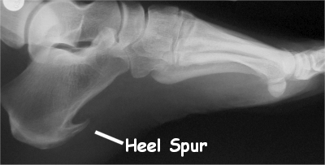
calcaneal spur
Wight shadow seen in the heel or in the calcaneal –

Slide 23
Rheumatoid arthritis
narrowing of the joints space
bone damage (erosions)

Slide 24
soft tissue swelling
fusiform and periarticular; it represents a combination of joint effusion, edema and tenosynovitis ⁵
this can be an early/only radiographic finding
osteoporosis: initially juxta-articular, and later generalized; compounded by corticosteroid therapy and disuse
joint space narrowing: symmetrical or concentric
marginal erosions: due to erosion by pannus of the bony “bare areas

Slide 25
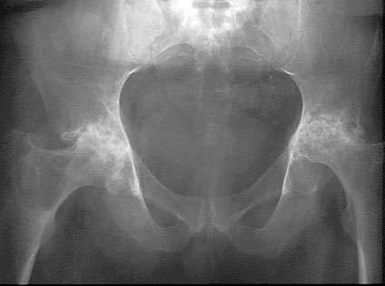
Rheumatoid arthritis

Slide 27
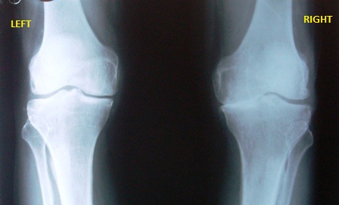
osteoarthritis

Slide 29
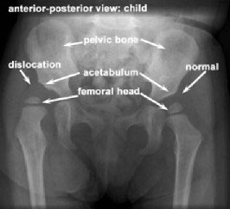
Developmental dysplasia of the hip

Slide 30
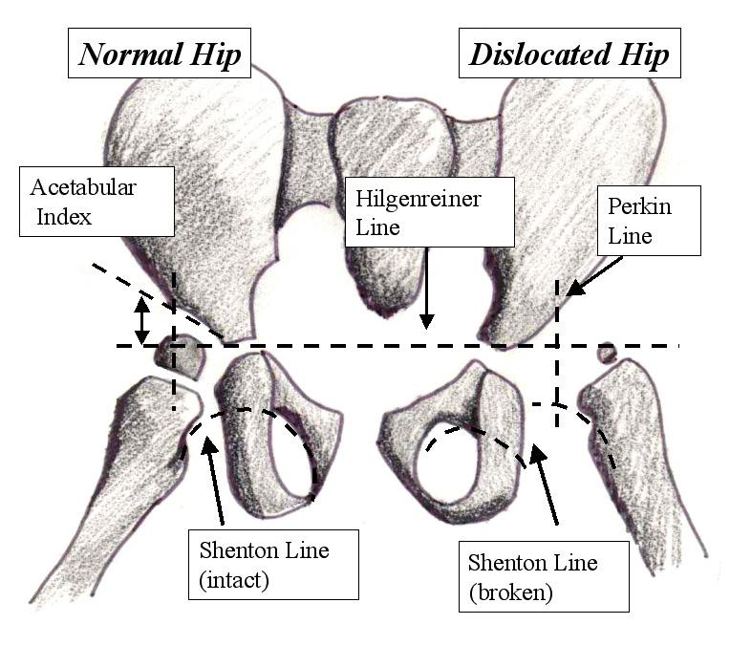
anteroposterior radiograph of hips, horizontal line (Hilgenreiner line) is drawn between each triradiate cartilage. Next, lines are drawn perpendicular to Hilgenreiner line through superolateral edge of acetabulum (Perkin line), dividing hip into 4 quadrants. Proximal medial femur should be in lower medial quadrant, or ossific nucleus of femoral head, if present (usually observed in patients aged 4-7 months), should be in lower medial quadrant. Acetabular index is angle between Hilgenreiner line and line drawn from triradiate cartilage to lateral edge of acetabulum. Typically, this angle decreases with age and should measure less than 20° by 2 years of age. Shenton line is drawn from medial aspect of femoral neck to inferior border of pubic rami. It should create smooth arc that is not disrupted. Disruption of Shenton line indicates presence of some degree of hip subluxation

Slide 31
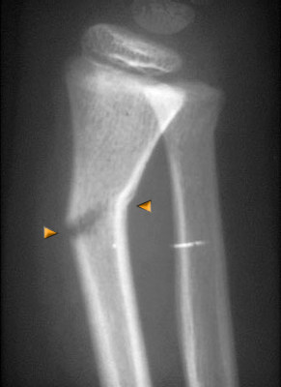
Green stick fracture

Slide 32
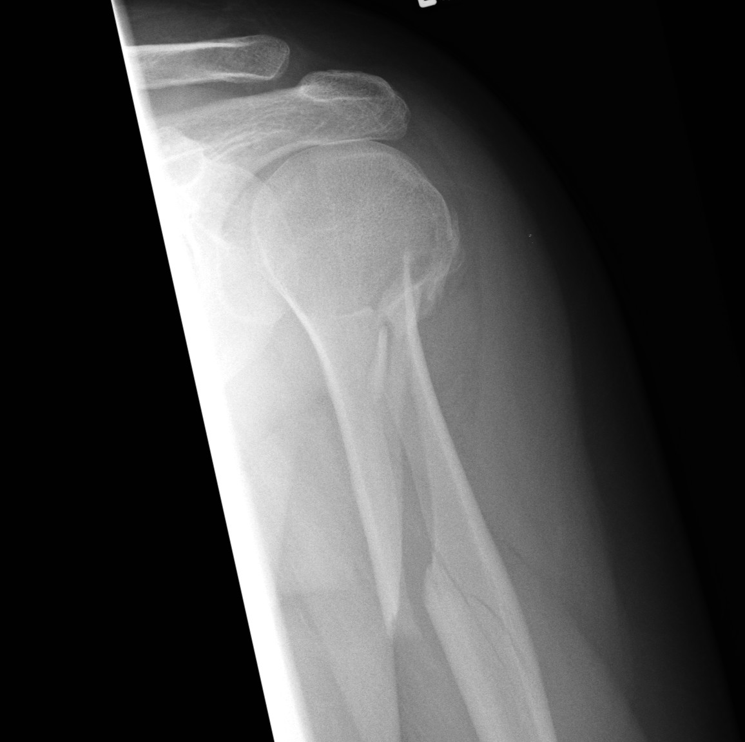
Oblique fracture

Slide 33
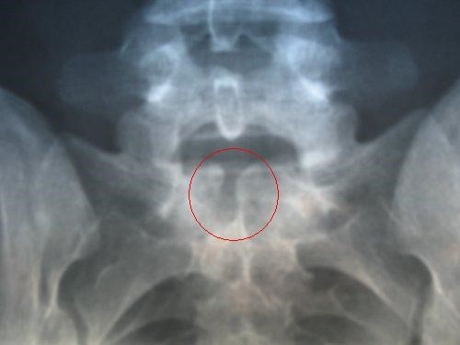
Spina bifida

Slide 34
interpedicular widening, hemivertebrae, and fusion of the vertebral bodies and lamina
plain radiographs may demonstrate a bony spur

Slide 35
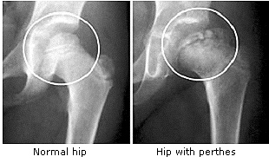
Perthes disease

Slide 36
femoral head deformity with widening and flattening (coxa plana) proximal femoral neck deformity: coxa magna. "sagging rope sign" (thin sclerotic line running across the femoral neck)

Slide 37
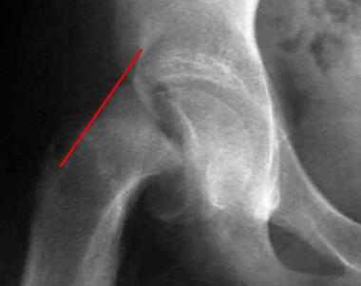
Slipped upper femoral epiphysis

Slide 38
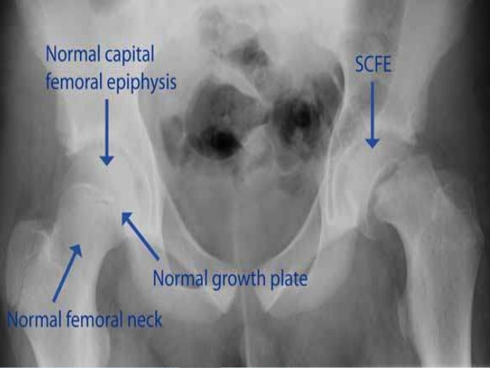

Slide 39
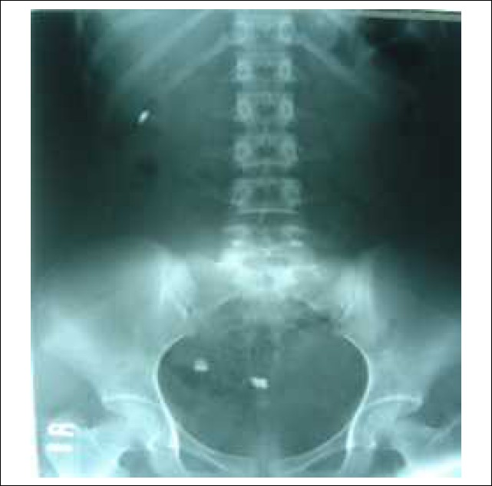

Slide 41
Thank you

